Slide 1
FUNDACION UNIVERSITARIA SAN MATEO
PRESENTADO POR:
LAURA ESTEFANIA SEPULVEDA BARRAGAN
TEMA:
CALENDARIO Y ANIMAL FAVORITO
TUTORA:
LILIANA HERNANDEZ
MATERIA:
INGLES

Slide 2

JANUARY
JANUARY
SUNDAY | MONDAY | TUESDAY | WEDNESDAY | THURSDAY | FRIDAY | SATURDAY
One 1 | Two 2 | Three 3 | Four 4 | Five 5 | Six 6 | Seven 7
Eight 8 | Nine 9 | Ten 10 | Eleven 11 | Twelve 12 | Thirteen 13 | Fourteen 14
Fifteen 15 | Sixteen 16 | Seventeen 17 | Eighteen 18 | Nineteen 19 | Twenty 20 | Twenty-one 21
Twenty-two 22 | Twenty-three 23 | Twenty-four 24 | Twenty-five 25 FESTIVAL INTERNACIO- | Twenty-six 26 | Twenty-seven 27 | Twenty-eight 28
Twenty-nine 29 | Thirty 30 | Thirty-one 31 | NAL DE LA MUSICA.
2019

Slide 3
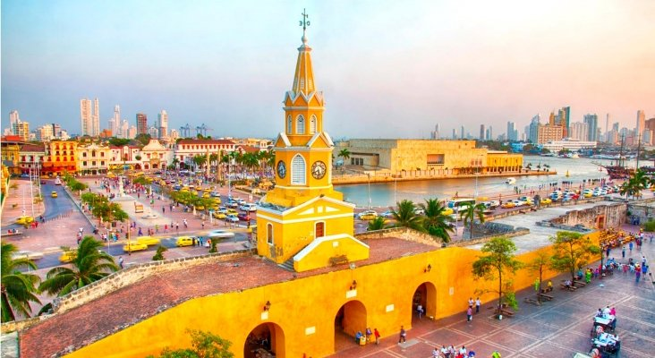
FEBRUARY
FEBRUARY
Cartagena
SUNDAY | MONDAY | TUESDAY | WEDNESDAY | THURSDAY | FRIDAY | SATURDAY
One 1 | Two 2 | Three 3 | Four 4 | Five 5 | Six 6 | Seven 7
Eight 8 | Nine 9 | Ten 10 | Eleven 11 | Twelve 12 | Thirteen 13 | Fourteen 14
Fifteen 15 | Sixteen 16 | Seventeen 17 | Eighteen 18 | Nineteen 19 | Twenty 20 | Twenty-one 21
Twenty-two 22 | Twenty-three 23 | Twenty-four 24 | Twenty-five 25 | Twenty-six 26 FIESTAS DE INDEPENCIA | Twenty-seven 27 | Twenty-eight 28
Twenty-nine 29 | Thirty 30 | Thirty-one 31 |  | CONCURSO NACIONAL DE BELLEZA
2019

Slide 4
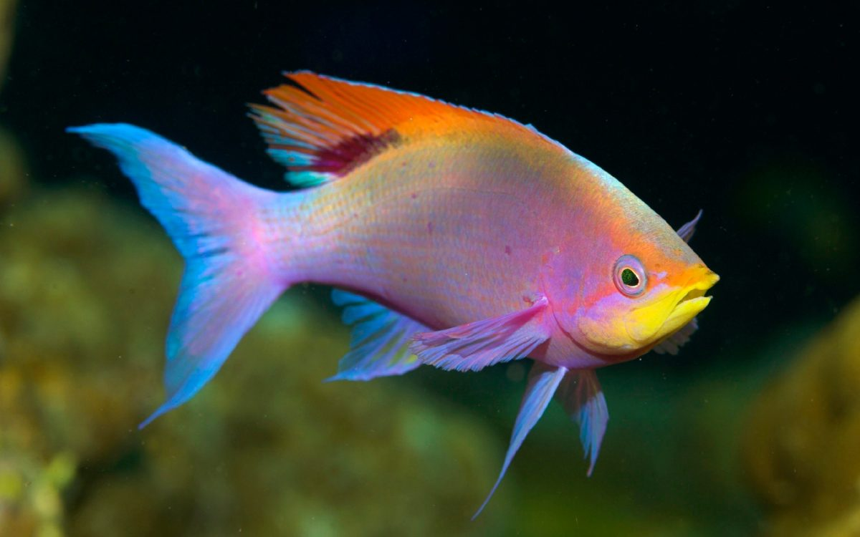
FISH (PEZ).
fish are aquatic vertebrate animals, their size is about 5 cm to 2 meters, their weight is about 0.5 to 1000 grams and their life is 2 to 8 years.
los peces son animales vertebrados acuáticos , su tamaño es de 5 cm a 2 metros aproximadamente , su peso es de 0.5 a 1000 gramos aproximadamente y su periodo de vida es de 2 a 8 años.

Slide 5
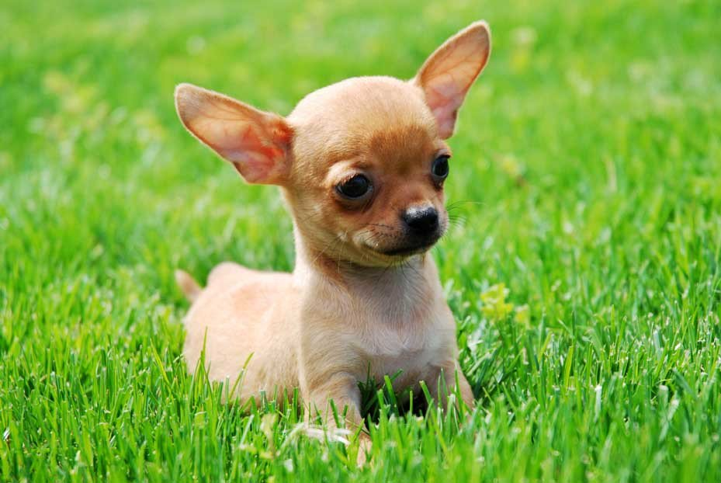
MY FAVORITE ANIMAL IS THE DOG
Hi, my name is Laura Sepulveda.
My favorite animal is the dog, it is carnivore I like dogs because they are very affectionate, they are of great company and protection for people, they defend us when we are in danger and they are part of the family, because they feel, show their affection, love and They do not abandon us, they are always with us until they die.
My dog ​​is loving, loving , very small and very beautiful.

Slide 6
MI ANIMAL FAVORITO ES EL PERRO
hola mi nombre es Laura Sepúlveda .
mi animal favorito es el perro , es carnívoro, me gustan los perros porque son muy cariñosos, son de gran compañía y protección para las personas, nos defienden cuando estamos en peligro y hacen parte de la familia , porque sienten , demuestran su cariño , amor y no nos abandonan, siempre están con nosotros hasta que mueren.
mi perro es cariñoso , amoroso, muy pequeño y muy hermoso.

Slide 7
https://drive.google.com/a/funsanmateo.edu.co/file/d/1Wk_esyOdtl7OXYYWX11r0-aSg3-l0IsD/view?usp=drivesdk

